Slide 1
Understanding XML & XPath

Slide 2
Agenda
Browser Settings
XML Refresher
Let’s learn XPath!
Notes:
XPath is the standard way of identifying objects.
In this module we’ll start with an XML refresher and then learn XPath basics.
If you are familiar with XML we can skip ahead to the XPath section.

Slide 3
Browser Settings
Notes:
Perfecto offers an Object Spy tool to identify objects. However, in some cases we will want to look manually at the XML and find our own XPath. Chrome offers a built in tool for this which we will use as needed.

Slide 4
Chrome - Developer Tools
Chrome’s developer tools (F12 to enable) has multiple ways of testing out your xPath statements
In the console you can use the $x() method

Slide 5
Chrome - Developer Tools
2. In the Element windows press CTRL+F to bring up search and enter your xPath in the box and search

Slide 6
XML Refresher
XML Refresher

Slide 7
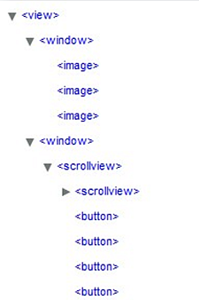
XML High Level
In Object-based Scripting
The Object Tree is an XML document.
Basic
Object
Tree
XML (Extensible Markup Language) is one of the most widely-used formats for sharing structured information (data) today. This data can be shared locally or over a network and be read by humans and software.
Basic
XML
Doc
Notes:
XML: (Extensible mark up language) – one of the most widely used formats for sharing data.
Similar to HTML but XML syntax rules are very strict.

Slide 8
Anatomy of an XML document - Elements
Elements (are also called Nodes)
Element markup begins with a < and ends with a >.
In the sample above, <vehicles>, <cars>, and <car> are elements.
An Element always consists of an opening and closing “tag”
Opening: <vehicles>
Closing: </vehicles>
An element’s value is the content between the Opening and Closing tags.
<car>Corolla</car>
Notes:
Let’s talk about the terms
Example of XML document
First step: identifying the element or object on the device screen that we would like to work with.
ELEMENTS are nodes encased in tags. They have a start tag and end tag. Elements can also have a value and the value is the content between the start and end tag.
An element can have any name. XML does not limit the names
-You can have multiple elements with the same name.
-In long complex XML files you will see many duplicate element names.
-------------
-Since elements have values, we can specify both the element name, and also its value.
The example contains elements, (also called nodes), attributes and their values.

Slide 9
Anatomy of an XML document - Attributes
Attributes
Attributes consist of a key/value pair that exists within a the element opening tag. Element closing tags should never contain an attribute.
The proper syntax for an attribute is (key="value“)
In the above example color, make, mpg, and model are attributes
Any element can have zero (0) or more attributes
<vehicle color="red" make="Honda“ >Civic</vehicle>
Notes:
Attributes provide a “description” of the element
In this case: make, describes each vehicle element.
Some more examples of attributes. If you just say vehicle it’s not specific enough.
“give me a blue vehicle". -> look for element vehicle with attribute ‘color = blue”
Now that we know the basics of elements and attributes, and that we need both to find our objects, let’s put this all together…

Slide 10
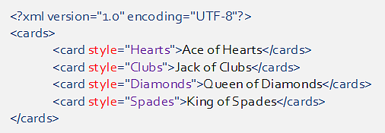
Knowledge Check!
Which are elements?
Which are the attributes?
Which are the attribute values?
Notes:
Which are elements? Card, cards
Which are the element values? Ace of Hears, Jack of Clubs, Queen of Diamonds, King of Spades
Which are the attributes? style
Which are the attribute values? Hearts, clubs, diamonds, spades

Slide 11
XPath Basics
Learning XPath
Notes:
Now that we know the XML structure, we need to find a way to identify a particular line of the XML by node, attribute, value or other criteria. The language in which this is done is called XPath and we will learn it today.

Slide 12
What is XPath?
XPath is
A query language used to find nodes (objects or elements) in an XML document
An industry standard
Similar to the concept of an SQL query and a database
Case sensitive
XPath can query based on
Absolute and/or Relative location
Element value and/or type
Attribute value and/or type
Relationship to other objects
XPath returns
An Element or array of Elements

Slide 13
Anatomy of an xPath expression
//car[@color="red"]
Values placed within the square brackets [] indicates they “belong to” the node in the preceding text. Secondary use would be placing a numeric value in [] would represent an index.
The selection modifier
// for relative
/ for absolute
Either the
Element //car
Attribute //@color
you are targeting
The @ symbol identifies the proceeding text as an attribute name
In plain English the above expression says “Return all car objects regardless of where they exist in the object tree where the object contain an attribute named color with a value of red”.
Keeping with the SQL comparison this would be similar to “select car from objectTree where color=‘red’;”
The SQL comparison is introduced here because its syntax is fairly close to plain English. Until you are an expert at constructing xPath expressions you may want to write down exactly what you are trying to accomplish in English or SQL before constructing your xPath. After its written you can introduce the xPath syntax required to accomplish each task.
Notes:
Selection modifier
The selection modifier allows you to use an absolute path /vehicles/cars/car or a relative path //car
Using relative paths take longer to perform however they are the most flexible and robust way to perform xPath statements
Element or attribute
You can target either an element using just the node name“car” or the attribute with an @ “@color”
Square Brackets
Indicates the values placed here belong to the text in the preceding text //car[@color=“red”] means the attribute of color within a node named car. Secondary use would be index //car[1] first car element //car[2] second car element, etc

Slide 14
XPath Syntax – Wild Cards
Wild Card | Description
* | Matches any element //*[@color=“red”] “Select any element which contains an attribute of color with a value of red”
@* | Matches any attribute //car[@*="red"] “Select all car elements which contain ANY attribute which contains a value of red”
node() | Matches any node regardless of type //node()[@color=“red”] “Select any element which contains an attribute name color with the value of red”
name() | Matches an element name //*[starts-with(name(), ‘C')] “Select any element which starts with the lower case letter c” **More on the additional syntax later
Notes:
DEMO – instructor should demonstrate each of the rows functionality using r Chrome with the xml document attached in the references section or http://nxc.co.il/demoaut/pages/xPath.php
INSTRUCTOR: We should mention that we aren’t covering 100% of all the functions available with xPath but the most commonly used. The trainees should lookup additional xPath information if they desire to look into it further (some links in the references they can look at)

Slide 15
XPath Syntax - Operators
Operator | Description
[ ] | Children of the preceding element Numeric values within [] represent an index
| | Combine more than one xPath expression. //car[@color="red"]|//car[@color="blue"] “Select all car elements which contain an attribute of color and have a value of either red or blue”
Or, and | Boolean modifier //car[@color="red" and (@make="Chevrolet" or @make="Mazda")] “Select all car elements which contain and attribute of color where its value is red and contains an attribute of make where its value is either Chevrolet or Mazda”
=, != | Boolean modifier //car[@color="red" and @make!="Chevrolet"] “Select all car elements which contain and attribute of color where its value is red and contains an attribute of make where its value is NOT Chevrolet”
( ) | Logical grouping See Or, and example above
Notes:
DEMO – instructor should demonstrate each of the rows functionality using Chrome with the xml document attached in the references section or http://nxc.co.il/demoaut/pages/xPath.php
INSTRUCTOR: We should mention that we aren’t covering 100% of all the functions available with xPath but the most commonly used. The trainees should lookup additional xPath information if they desire to look into it further (some links in the references they can look at)

Slide 16
Knowledge Check!
Which of the following describes an element called car which has an attribute of make with the value of Toyota?
1. //*[text()=‘Toyota’]
2. //*[@make=‘Toyota’]
3. //vehicles[@color=‘blue’]
4. //car[@make=‘Toyota’]
Notes:
Let’s try some questions
------------
Answers:
1. This is looking for any element with the text (Toyota). We asked for the make and ensure that the element is a car. This could match on any node containing a value of Toyota
2. This is looking for only make=Toyota. But it doesn’t account for the car element. What if there is another element (apart from vehicle) with make=Toyota. Not unique enough
3. This wouldn’t match anything because its look for a vehicles element which has an attribute of color with the value of blue
4. This is correct.
We are stating very specifically (and uniquely):
The element is car
The attribute we are looking for (make) and its value, Toyota.

Slide 17
Knowledge Check!
Which of the following describes an element called car which has an attribute of color with the value of black?
1. //*[text()=‘Civic’]
2. //*[@make=‘Honda’]
3. //*[@color=‘black’]
4. //car[@color=‘black’]
Notes:
Answers:
1. This will not work.
This is looking generically the text value of an element to be Civic. What happens if there are multiple Civic cars? This will not work.
2. This will not work.
It is looking for all Hondas, not all black cars. What happens if there is a black Toyota car? It won't find it.
3. This will pull up anything on the site that has a color attribute = black.
So....what if this site also sells other items that are black in color? We are specifically asking for a car.
4. This is correct.
We are stating very specifically (and uniquely):
The element is car
The attribute we are looking for (color) and its value, black.

Slide 18
Knowledge Check!
Which of the following describes all elements with the text ‘Silverado’?
1. //*[text()=‘Silverado’]
2. //*[@make=‘Chevrolet’]
3. //*[@color=‘red’]
4. //car[@make=‘Chevrolet’]
Notes:
Answers:
1. This is correct.
Your looking for all objects with the text 'Silverado'. The * indicates 'all elements'.
2. Nope. What if page contains other Chevrolet vehicles that are not Silverado. This line will pull up all Chevrolets. May not be unique enough....
3. Not what we asked for. We want text, 'Silverado'. Even though Silverado happens to be red, this path will pull up all objects that are red on the page and therefore, this is not correct.
4. This could work, but.... What if there are other elements with the text Silverado. You will miss them because you specified car. Also, since you’ve specified make=Chevrolet, it will pull up all Chevys. Not just Silverado.

Slide 19
xPath Syntax – Position Functions
Function | Description
last() | Can return the last child of an element (//car[@color="red"])[last()] “Select all car elements who have a color attribute with the value of red, AND THEN return only the last element.”
position() | Can return the specific location of a child of the element (//car[@color="red"])[position()=2] “Select all car elements who have a color attribute with the value of red, AND THEN return only the second element.”
count() | Can return elements based on a count of child attributes or elements //*[count(*)>2] “Select any element which contains more than 2 child elements”
Notes:
DEMO – instructor should demonstrate each of the rows functionality using Firefox or Chrome with the xml document attached in the references section or http://nxc.co.il/demoaut/pages/xPath.php
INSTRUCTOR: We should mention that we aren’t covering 100% of all the functions available with xPath but the most commonly used. The trainees should lookup additional xPath information if they desire to look into it further (some links in the references they can look at)

Slide 20
XPath Syntax – String Functions XPath 1.0
Function | Description
starts-with() | Matches the first characters of the element or attribute value of the string //car[starts-with(@color,"r")] “Select all car elements who have an attribute of color and the value begins with ‘r’.”
contains() | Matches the element or attribute to the string value //car[contains(@color,"ed")] “Select all car elements who have an attribute of color which contains the characters ‘ed’.”
translate() | Can be used to do upper and lower case in xPath 1.0 //car[translate(@make, 'ABCDEFGHIJKLMNOPQRSTUVWXYZ', 'abcdefghijklmnopqrstuvwxyz')="chevrolet"] “Select all car elements who have an attribute of make with a lower case value of Chevrolet”
Notes:
DEMO – instructor should demonstrate each of the rows functionality using Chrome with the xml document attached in the references section or http://nxc.co.il/demoaut/pages/xPath.php
INSTRUCTOR: We should mention that we aren’t covering 100% of all the functions available with xPath but the most commonly used. The trainees should lookup additional xPath information if they desire to look into it further (some links in the references they can look at)

Slide 21
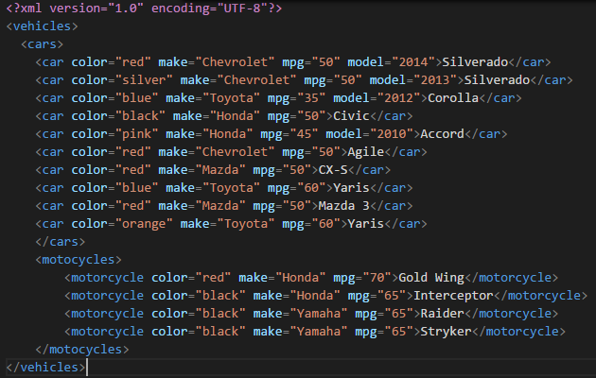
Knowledge Check!
Which of the following describes an element which contains an attribute of color with a value of either blue or red”
//car[(@color="blue" or @color="red")]
//*[(@color="blue" or @color="red")]
//car[@color="blue"]
//car[@color="blue"]|//car[@color="red"]
Notes:
Answers:
1. Nope this finds only car elements with the color of red or blue
Correct finds every element with color red or blue
3. Only looking for blue of car element
4. So close but again this only looks for the car element and not all elements

Slide 22
Knowledge Check!
Write an XPath expression which describes any element which contains an attribute of mpg which is equal or greater than 60.
Notes:
Ok its getting a little harder, give them 3 minutes to do this on their own: http://nxc.co.il/demoaut/pages/xPath.php
Correct answer //*[@mpg>=60] or //node()[@mpg>=60]

Slide 23
Knowledge Check!
Write an XPath expression which describes all elements which contain an attribute of color that starts with the letter b.
Notes:
Ok its getting a little harder, give them 3 minutes to do this on their own: http://nxc.co.il/demoaut/pages/xPath.php
//*[starts-with(@color,"b")] or //node()[starts-with(@color,"b")]

Slide 24
xPath Syntax – Axes
Function | Description
child() | Return an element where it has a specific child element //cars/child::car “Select all cars elements who children elements of car.”
following-sibling | Returns an element where it has a specific “sibling” element after it //car[@color="red"]/following-sibling::car[@color="blue"] “Find all car elements who have an attribute of color with a value of red and return all the sibling after which has an attribute of color with the value of blue”
preceding-sibling() | Returns an element where it has a specific “sibling” element before it //car[@color="red"]/preceding-sibling::car[@color="blue"] “Find all car elements who have an attribute of color with a value of red and return all the siblings before which has an attribute of color with the value of blue”
Notes:
DEMO – instructor should demonstrate each of the rows functionality using Firefox or Chrome with the xml document attached in the references section or http://nxc.co.il/demoaut/pages/xPath.php
INSTRUCTOR: We should mention that we aren’t covering 100% of all the functions available with xPath but the most commonly used. The trainees should lookup additional xPath information if they desire to look into it further (some links in the references they can look at)

Slide 25
Knowledge Check!
Write an XPath expression which describes all elements which have an attribute of color with a value of black and an attribute of MPG which contains the number 5.
Notes:
Even harder, give them 3 minutes to do this on their own: http://nxc.co.il/demoaut/pages/xPath.php
Answer //*[@color="black" and contains(@mpg,"5")] or //node()[@color="black" and contains(@mpg,"5")]

Slide 26
Knowledge Check!
Write an XPath expression which describes the previous element which contain an attribute of mpg with a value greater than or equal to 50 of a car element which contains an attribute of color with a value of black.
Notes:
Harder still!, give them 3 minutes to do this on their own: http://nxc.co.il/demoaut/pages/xPath.php
//car[@color="black"]/preceding-sibling::*[@mpg>=50] or //car[@color="black"]/preceding-sibling::node()[@mpg>=50]

Slide 27
Knowledge Check!
Write an XPath expression which describes the last child element of the motorcycles element which contains a make attribute with the value of Honda.
Notes:
Hardest master level! ☺, give them 5 minutes to do this on their own: http://nxc.co.il/demoaut/pages/xPath.php
Answer //motocycles/child::motorcycle[@make="Honda"][last()]

Slide 28
XPath Syntax – String Functions xPath 2.0
Perfecto supports XPath 2.0 for Native and Web Applications. Validation of the XPath 2.0 expressions should be
performed using the Perfecto CQ Lab Object Spy.
Function | Description
ends-with() | Matches the last characters of the element or attribute to the value of the string //textfield[ends-with(text(),"name")] “Select all text elements who have a text value which ends with “Mobile”
upper-case() | Similar to the translate function of xPath 1.0 but a lot less code //textfield[ends-with(upper-case(text()),"NAME")] “Select all text elements who have an UPPER CASE text value which ends with “MOBILE”
lower-case() | Similar to the translate function of xPath 1.0 but a lot less code //textfield[ends-with(lower-case(text()),"name")] “Select all text elements who have a LOWER CASE text value which ends with “MOBILE”
matches() | Using the matches method allows you to take advantage of regular expressions. Adding parameter value of “I” tells the matching logic to ignore case. //textfield[matches(text(),".*nAmE$","i")] “Select all text elements who have a text value of OBILE regardless of case”
Notes:
INSTRUCTOR: We should mention that we aren’t covering 100% of all the functions available with xPath but the most commonly used. The trainees should lookup additional xPath information if they desire to look into it further (some links in the references they can look at)

Slide 29
Summary
Throughout this session we have learned
What is XML and XPath
The anatomy of an XPath Expression
How to use XPath wildcards, operators, positions and axes
How to use XPath 1.0 and 2.0 String Functions
You should now have a firm understanding of how to use XPath effectively

Slide 30
Assignment
Improve or fix the following XPath statements:
Change the locator to use the text value

Slide 31
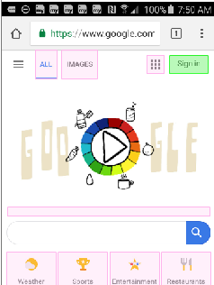
Assignment Continued
Change the locator to use the text value

Slide 32
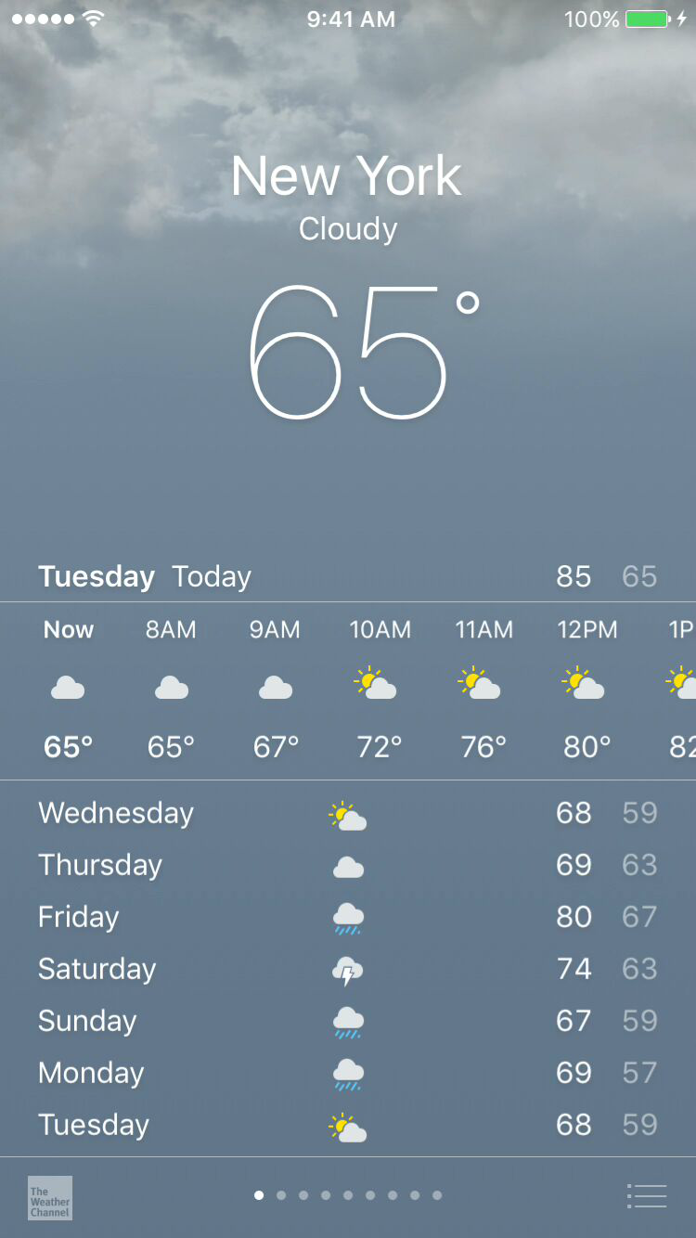
Assignment Continued
Change the below XPath to capture the City regardless of the current weather. //*[@label="New York, Cloudy, 65°, Tuesday, Partly Cloudy, High 85, Low 65"]
Notes:
Use the contains feature.

Slide 33
Assignment Continued
Select a blue Toyota Yaris <car color="blue" make="Toyota" mpg="60">Yaris</car> <car color="red" make="Mazda" mpg="50">Mazda 3</car> <car color="orange" make="Toyota" mpg="60">Yaris</car>

Slide 34
Assignment Continued
Select all the pink cars with mpg of 45. http://nxc.co.il/demoaut/pages/xPath.php

Slide 35
Resources
Sample site:
http://nxc.co.il/demoaut/pages/xPath.php
Example XML:
References
Working with Object Spy & xPath
https://community.perfectomobile.com/posts/914140
XML Tutorial
http://www.w3schools.com/xml/
xPath Tutorial
http://www.w3schools.com/xPath/
xPath 1.0
http://docs.oracle.com/javase/tutorial/jaxp/xslt/xPath.html
xPath 2.0
http://saxon.sourceforge.net/saxon7.4/functions.html
xPath 2.0 Tips
https://developers.perfectomobile.com/display/TT/XPath+2.0+Tips
Notes:
Talk to your development team about using similar object names to help make your scripts simpler

Slide 36
Thank You

